Slide 1
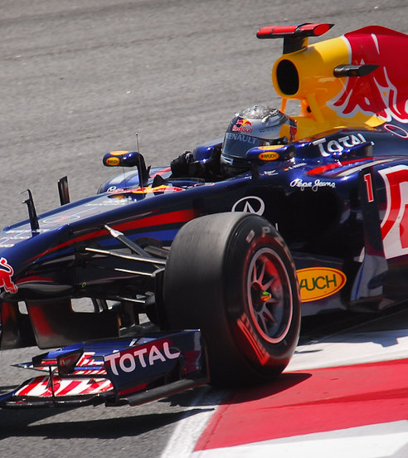
Formula 1 Themed Business Idea
By Hassan Zaidi

Slide 2
SO, which team(s) do we create the "theme" around?
According to the Data the following drivers are the most popular with viewers: Button, Hamilton, Ricciardo, Vettel, Fernando And the following teams were the most Popular with the Fans: Mercedes, Red bull, Mclaren and Ferrari

Slide 3

SO what does this mean?

Slide 4
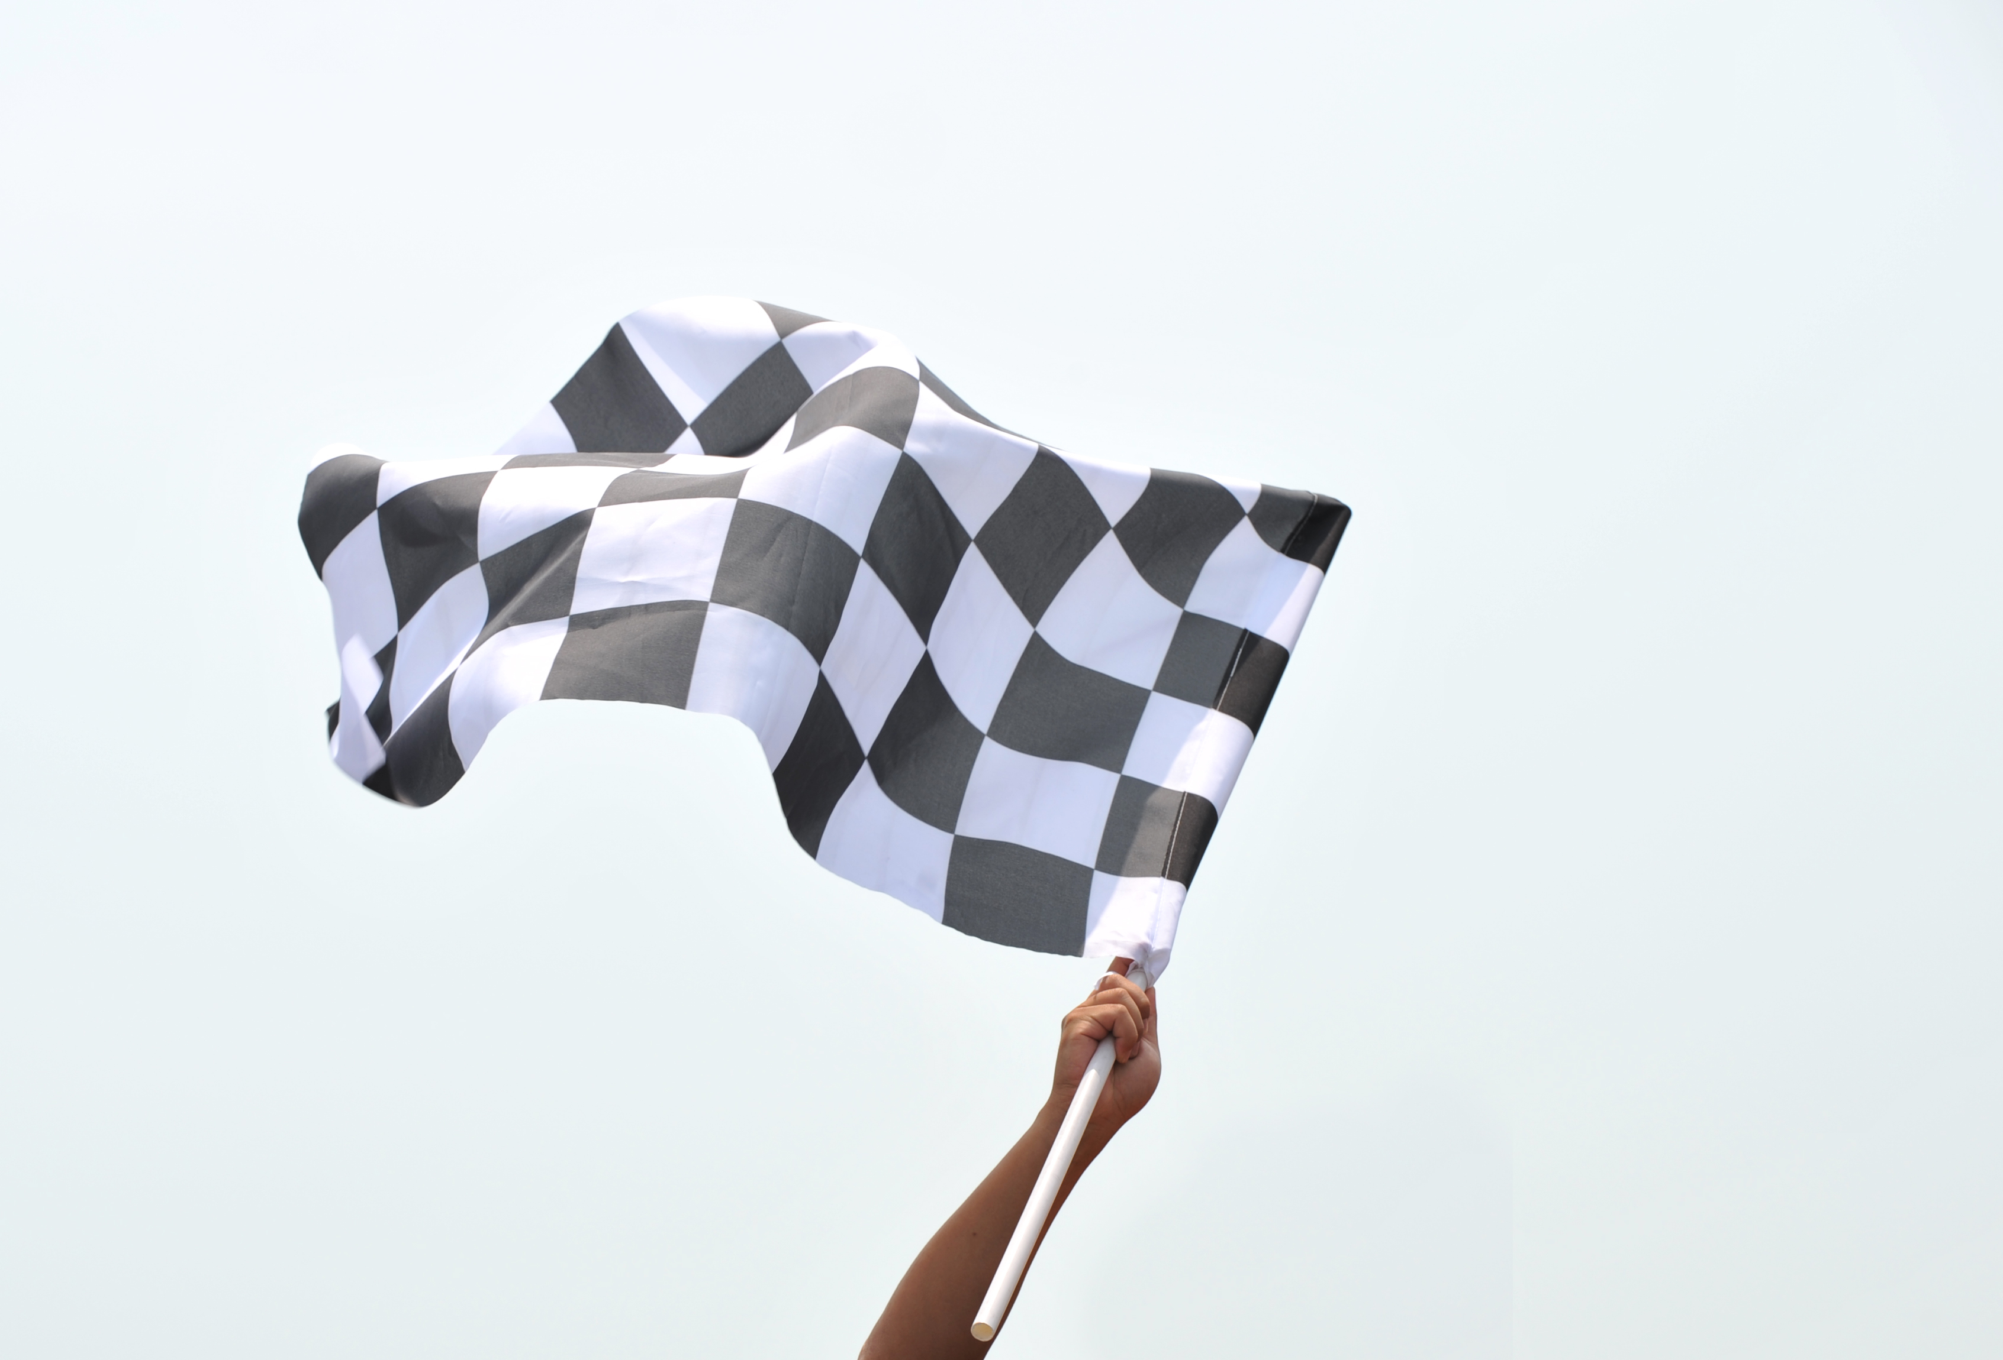
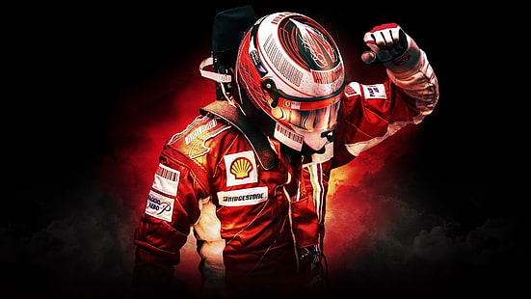
EVENTS!
This means that we can use these 'popular' drivers and teams to create the theme around these events to attract potential customers and provide the best value for money

Slide 5

Thank you

